Slide 1
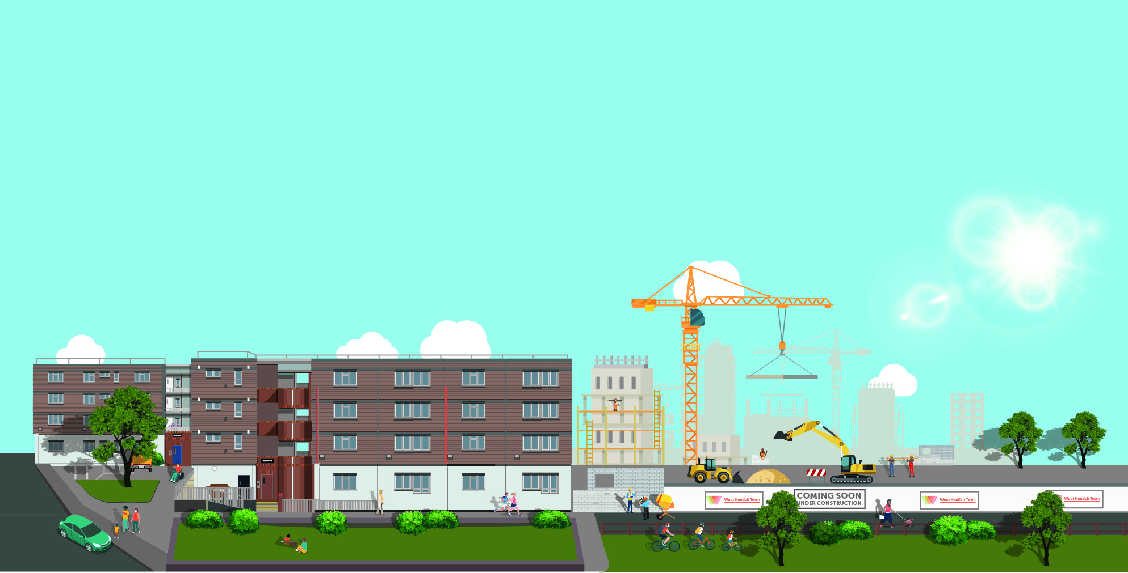


Future of West Kentish Town Estate
The Business Case for delivering the Regeneration Strategy
Cabinet Report July 2022

Slide 2
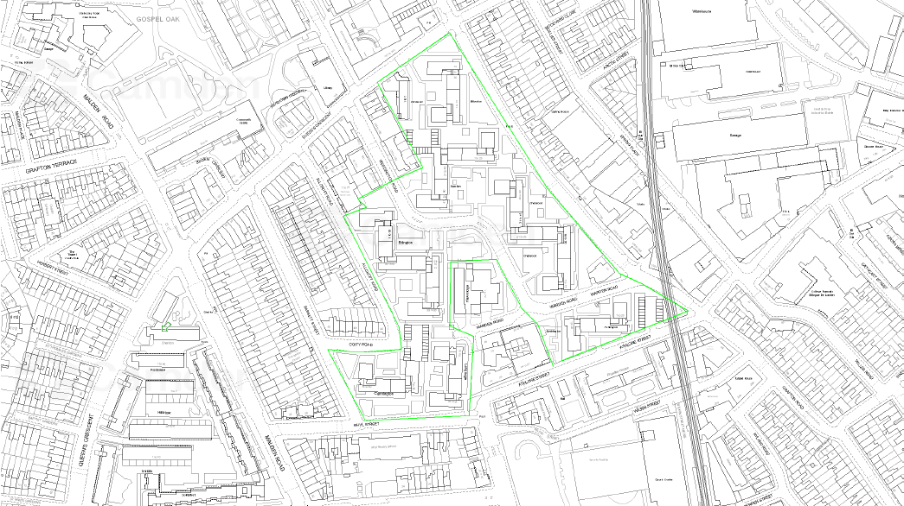
This report sets out the Regeneration Strategy and associated Business Case for West Kentish Town Estate regeneration. This follows on from the report of July 2019 which was approved by Cabinet, to proceed with full redevelopment of the estate, with the Council acting ‘as developer’ in delivery of the scheme.

Slide 3
CONTEXT & BACKGROUND
Consultation with local community since 2015
Feasibility Stage between 2017-19 examined current issues and preferred option
July 2019 Cabinet Report recommended full redevelopment with the Council acting as developer and delivering the scheme directly
Feb/Mar 2020 Resident Ballot: 93% in favour, on 84.9% turnout
Major issues with existing estate (structural deterioration, endemic repair issues, outdated construction and design) impacting on lives of residents (includes quotes)
Strategic Context: ‘We Make Camden’; ‘The Way We Work’ (Camden’s visions); employment opportunities; local economies; Camden’s Community Investment Programme; Zero-Carbon Camden by 2030

Slide 4
RECOMMENDATIONS
What we’re asking Cabinet to approve
Phases 1 – 8 will be delivered by the ‘Council as developer’
Immediate implementation:
Delegate authority to the Executive Director Supporting Communities (& others) the power to take all appropriate actions to progress and implement the Regeneration Strategy, including:
Further Cabinet Reports will be brought back to Cabinet to update
Agree Local Lettings Plans
the next stage of design
preparation and submission of a hybrid planning application, detailed for Phase 1 and outline for remaining phases (2-8)
construction of first two phases based on the indicative costs of £128,604,083
Acquisitions & disposals or securing vacant possession of residential & non-residential property
Agreeing contract award strategies
Making Compulsory Purchase Orders
Issuing Demolition notices, suspending Right to Buy
Authorise appropriation of Council land
In more detail….

Slide 5

PROPOSAL & REASONS
“Responsible development”
The Regeneration Strategy and Business Case are indicative and based on work undertaken to date and are subject to change. Detailed design and planning will take place in the next stages. Costs and income will be subject to wider economic factors. Contingencies and robust governance processes are in place and changes will be reviewed.
MASTERPLAN APPROACH:
developed and shaped by residents,
in line with requirements and constraints (planning, statutory, financial);
New high quality, larger homes (to address overcrowding based on HNS data; increase of circa 58% floorspace);
minimum 40% affordable;
landscape-led approach retaining trees & creating public & communal amenities;
good quality design and green routes;
phasing strategy enabling delivery, reducing disruption and prioritising single moves;
8 phases over 16 years approx.;
commercial units and improvements to Queen’s Crescent frontage.
Council tenants will not be moved out of the borough…will be given priority in new homes built…as far as possible straight into new homes…if not will be given a secure tenancy elsewhere until their new home is ready…Support will be given and a Local Lettings Plan updated to include new homes at Maitland Park.
Leaseholders will be offered a settlement package or shared equity to remain on their estate…Purchase & negotiations will be staggered according to phasing…an early buyback scheme is being developed.

Slide 6
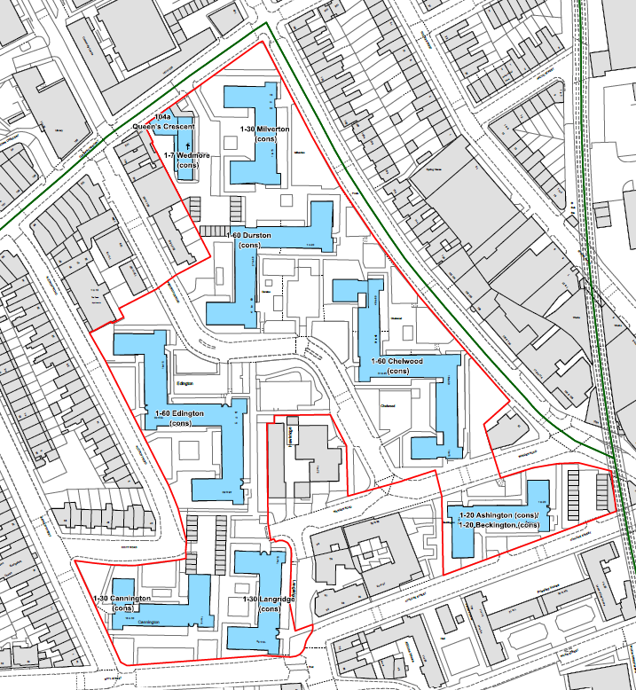
West Kentish Town Estate – Proposed Redevelopment Boundary
Redevelopment area (outlined in red) made up of the following Blocks:
WEDMORE (including 104 QC)
MILVERTON
LANGRIDGE
EDINGTON
DURSTON
CHELWOOD
CANNINGTON
BECKINGTON
ASHINGTON

Slide 7
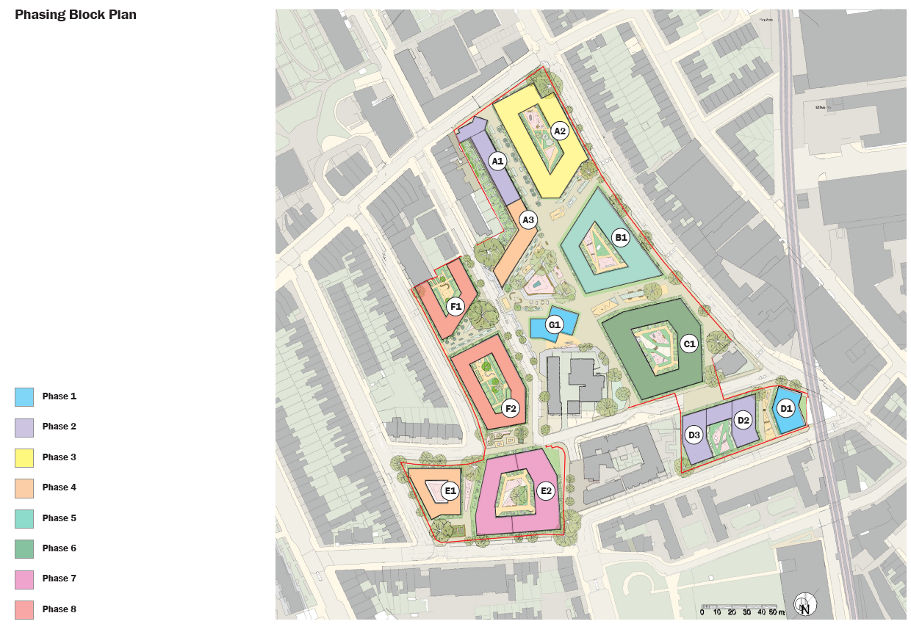
PHASING PLAN
Phase 1 includes 2 sites of garages (to be demolished) & Multi Use Games Area (MUGA) to be relocated)).
Phase 1 & 2 will deliver 218 homes (81 for existing residents, the remaining for sale including resident leaseholders).
Estimated cost for phases 1 & 2 is £128,604,083
A small proportion of residents may have to temporarily move off the estate until their new homes on West Kentish Town Estate are built. All council tenants that move off the estate can return if they choose to.

Slide 8
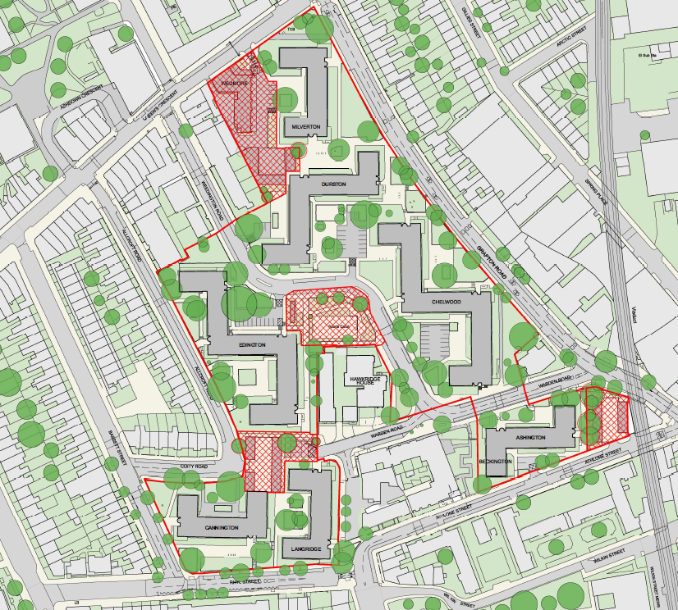
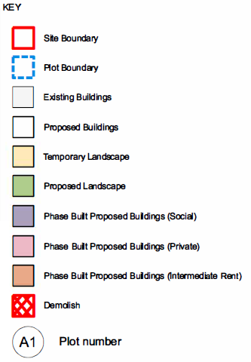
Sites Impacted by Phase 1 demolition
Indicative/Approximate Demolition date:
March 2023
Blocks to be demolished:
Garages
Ball court relocated
Potentially Wedmore

Slide 9
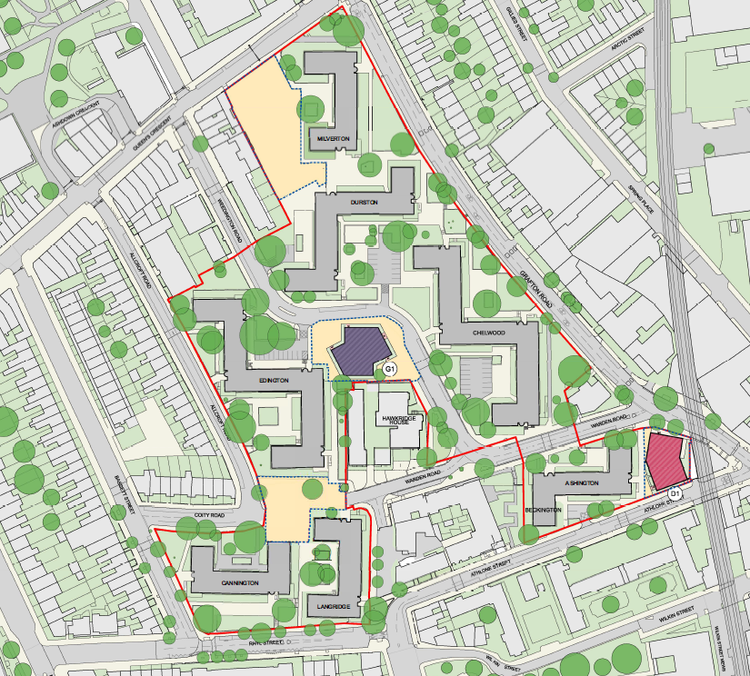
Proposed Phase 1 Development
Estimated Construction Period:
November 2023 – October 2025
Some residents will be able to move into their new homes starting at completion of this phase

Slide 10
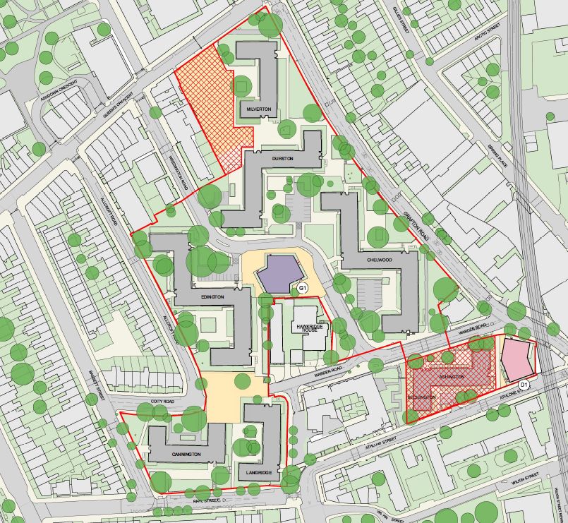
Sites to be cleared/ demolished to enable Phase 2
Indicative/Approximate Demolition date:
November 2025
Blocks to be demolished:
Wedmore
Ashington
Beckington

Slide 11
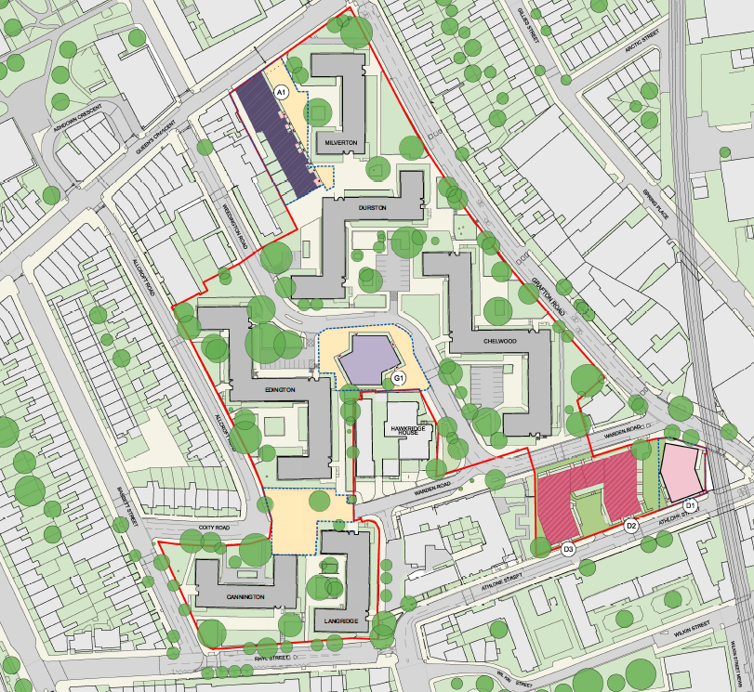
Proposed Phase 2 Development
Estimated Construction Period:
November 2025 – October 2027
Some residents will be able to move into their new homes at completion of this phase

Slide 12
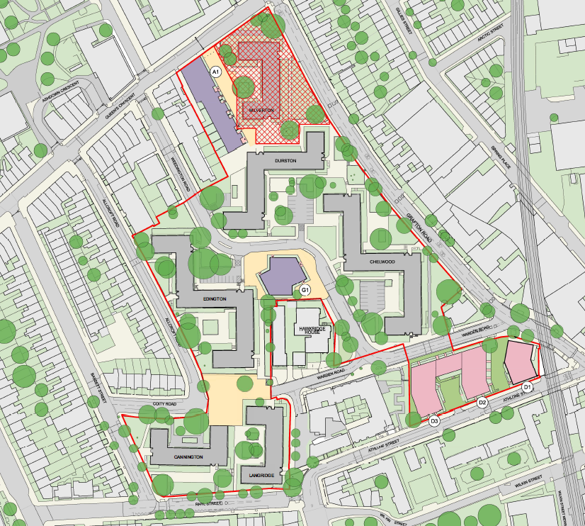
Sites to be cleared/ demolished to enable Phase 3
Indicative/Approximate Demolition date:
November 2027
Blocks to be demolished:
Milverton

Slide 13
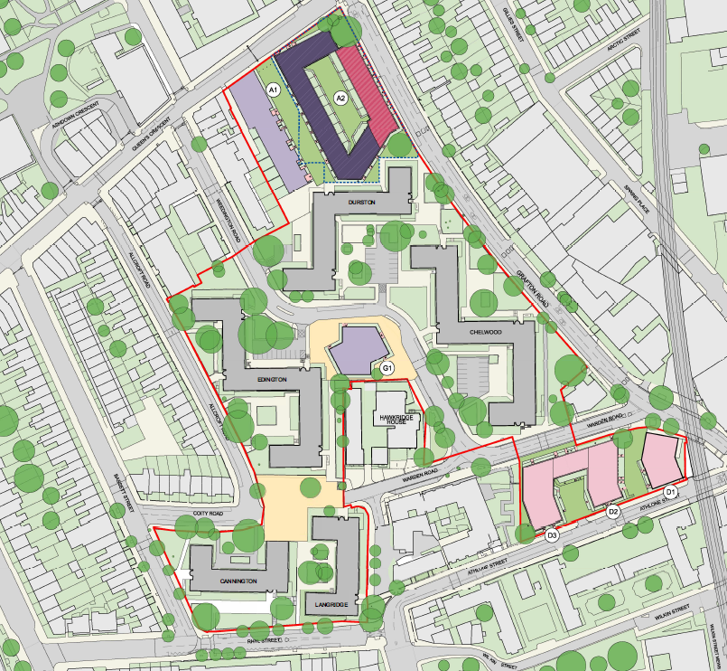
Proposed Phase 3 Development
Estimated Construction Period:
November 2027 – October 2029
Some residents will be able to move into their new homes at completion of this phase

Slide 14
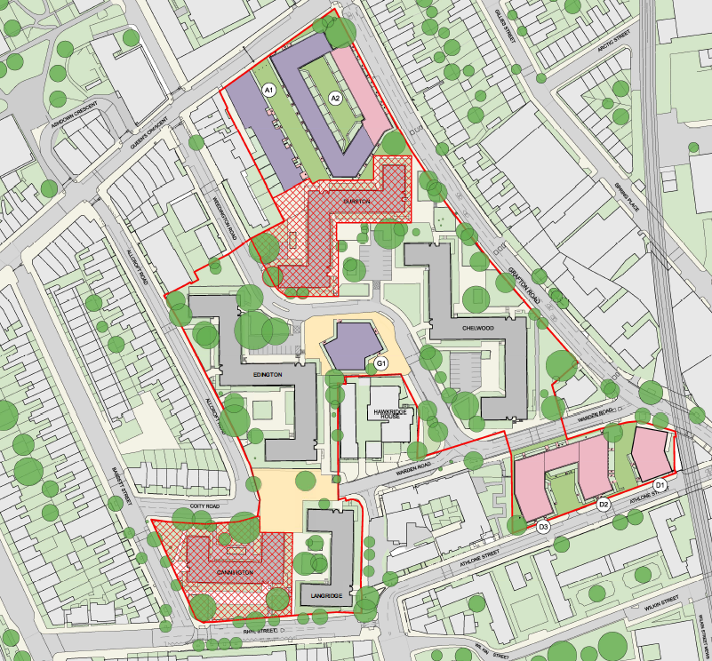
Sites to be cleared/ demolished to enable Phase 4
Indicative/Approximate Demolition date:
November 2029
Blocks to be demolished:
Durston
Cannington

Slide 15
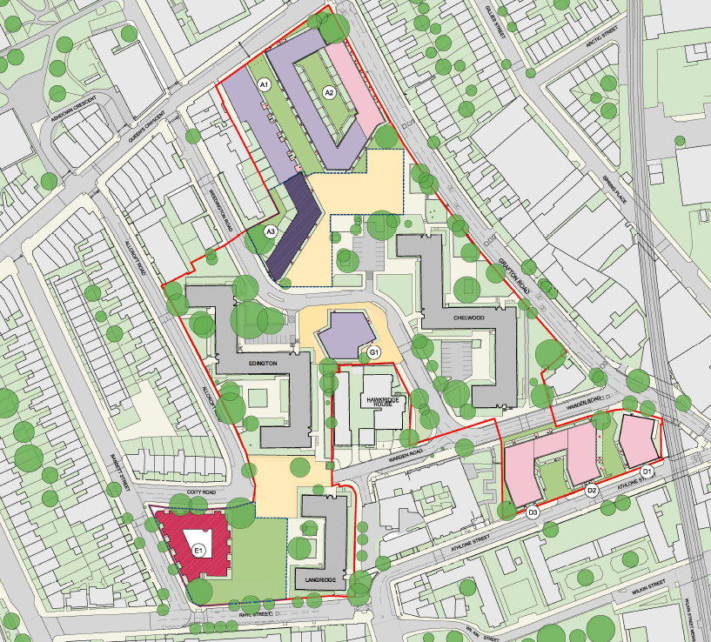
Proposed Phase 4 Development
Estimated Construction Period:
November 2029 – October 2031
Some residents will be able to move into their new homes at completion of this phase

Slide 16
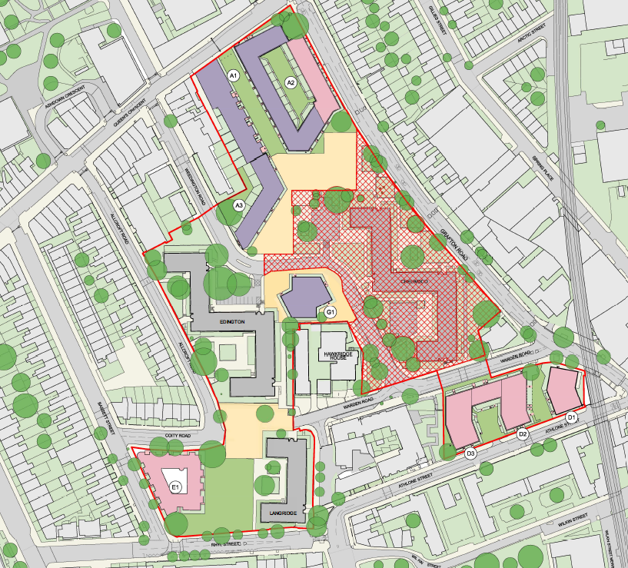
Sites to be cleared/ demolished to enable Phases 5 & 6
Indicative/Approximate Demolition date:
November 2031
Blocks to be demolished:
Chelwood

Slide 17
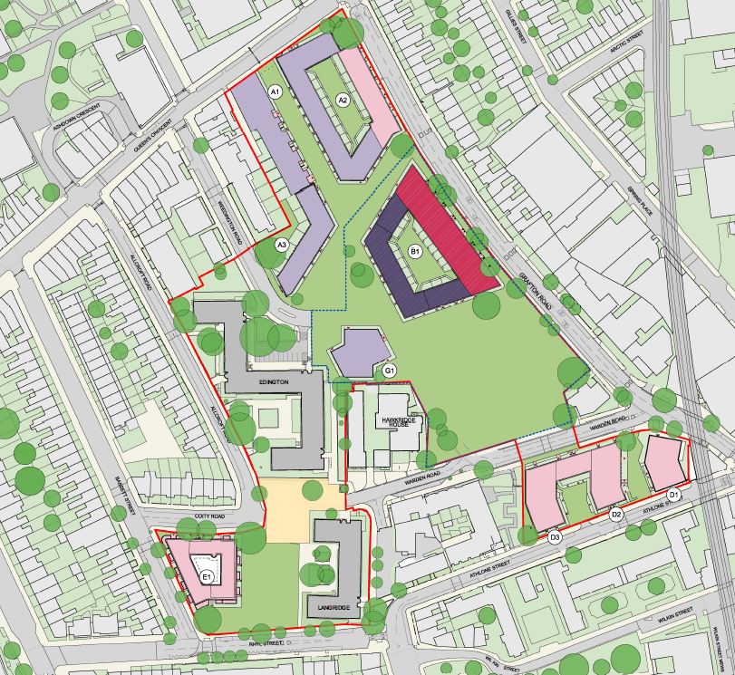
Proposed Phase 5 Development
Estimated Construction Period:
November 2031 – October 2033
By the end of this phase we expect the last few residents will have been re-housed to new homes. The council will endeavour to make this earlier.

Slide 18
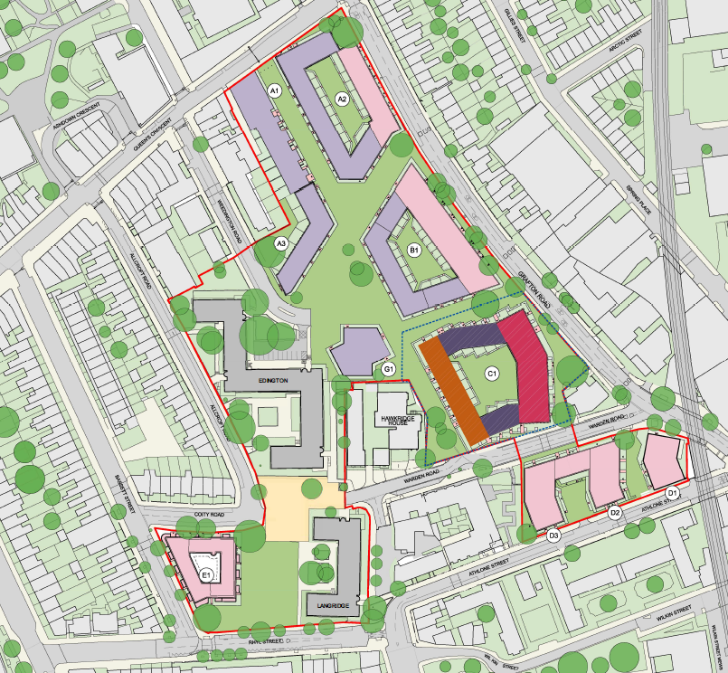
Proposed Phase 6 Development
Estimated Construction Period:
November 2033 – October 2035

Slide 19
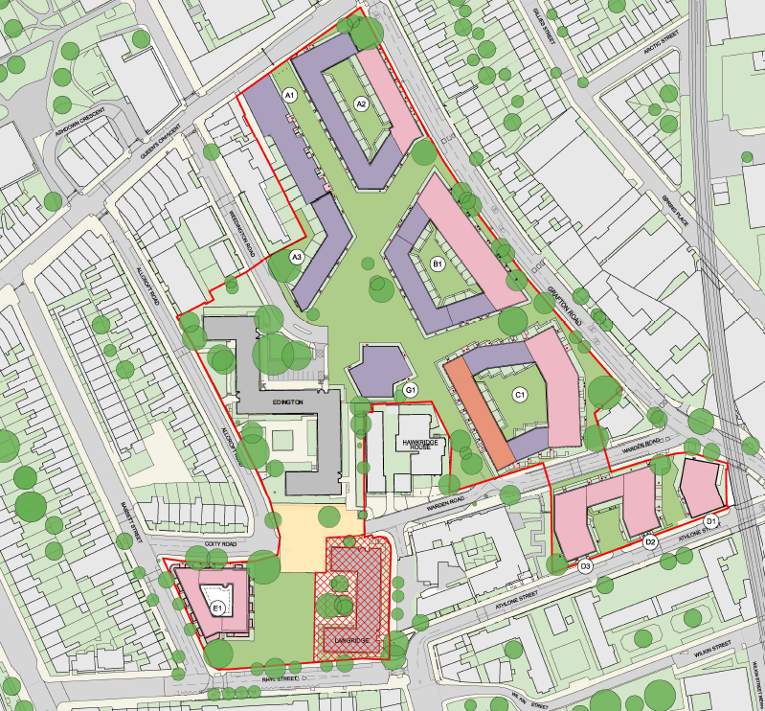
Sites to be cleared/ demolished to enable Phase 7
Indicative/Approximate Demolition date:
November 2035
Blocks to be demolished:
Langridge

Slide 20
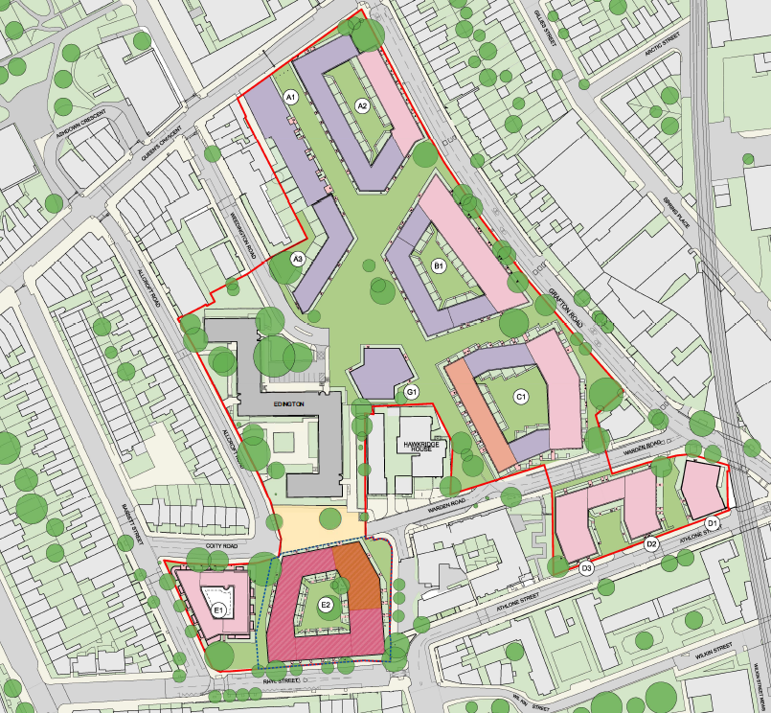
Proposed Phase 7 Development
Estimated Construction Period:
November 2035 – October 2037

Slide 21
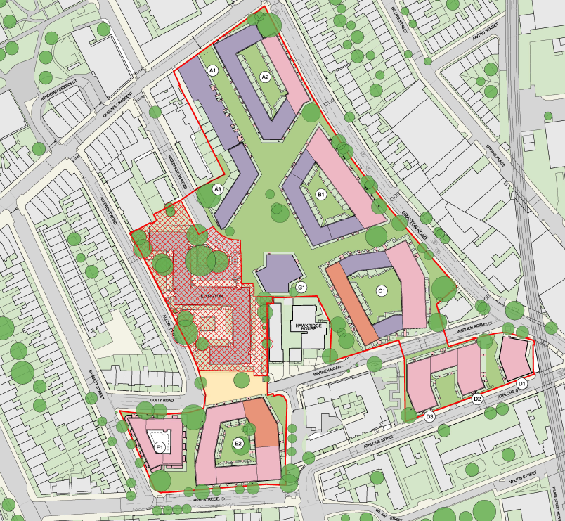
Sites to be cleared/ demolished to enable Phase 8
Indicative/Approximate Demolition date:
November 2037
Blocks to be demolished:
Edington

Slide 22
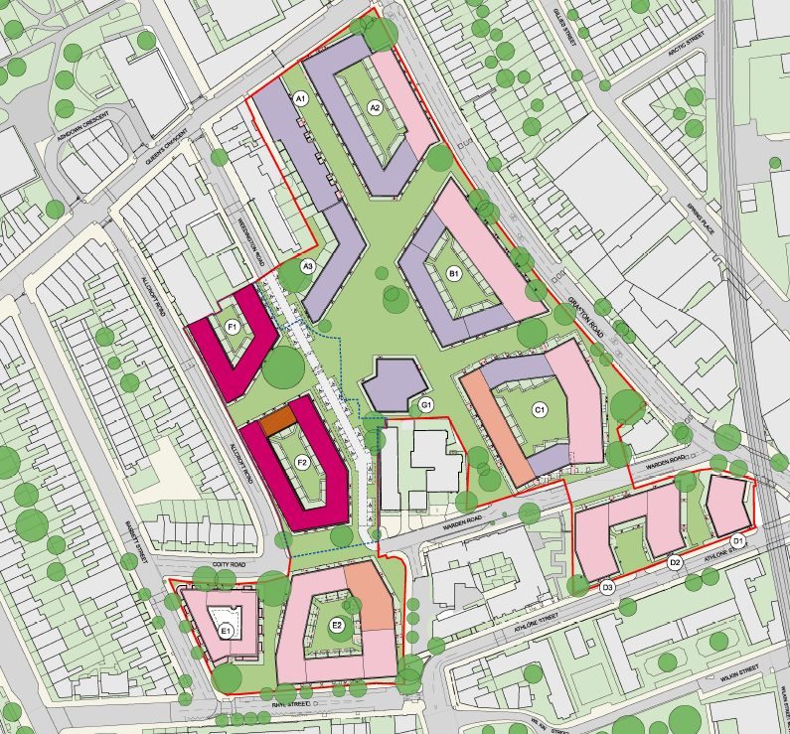
Proposed Phase 8 Development
Estimated Construction Period:
November 2037 – October 2039
Oct 2039: REGENERATION OF WEST KENTISH TOWN COMPLETE!

Slide 23
BUSINESS CASE & RISK MANAGEMENT
Based on the cost to develop Phases 1 – 8 and the income generated to meet the cost.
Main source of income will be from sale of private units (approx. 7.8% of which from GLA funding)
Measures to improve future viability and affordable housing quota: Phased delivery; Benchmarking and cost management; Cross subsidy; campaign for additional funding
RISK | MITIGATION
Cost increases (inflation, volatile market, macroeconomic pressure). | Efficient design; competitive procurement; contingencies; value management; regular review
Sales (impact on values) | Robust marketing; phased release; high quality design; prudent modelling
Planning (affordable housing provision; sustainability targets) | Early pre-application engagement; stages informed by planning policy
Programme (delay) | Regular review; early warning; opportunities for improving construction timescales
Impact on residents (extensive demolition / construction; need to decant) | Construction Management Plan; resources to support; identify vulnerable residents; action on equality impacts

Slide 24
ENVIRONMENTAL IMPLICATIONS
New homes built to higher sustainability standards (Council’s Climate Change Action Plan, GLA London Plan)
Recycling material from demolition
Green technology: air source heat pumps; solar roof panels; green / brown roofs; increased biodiversity in landscaping and urban drainage systems (SUDs); Dust / Air quality and noise monitoring (C/DMP)
CIP already installed pioneering Passivhaus and air source heat pumps reducing heating demand and fuel poverty
Environmental Impact Assessment; demolition / construction impacts assessed by Planning…and assessment of Retrofit…
Addressing the Climate Emergency: Retrofit versus new build
Architectural analysis indicates significant issues – “technically & financially unviable”
Unlikely to provide number or sizes of homes required
Only small uplift of floorspace
Inconclusive whether capable of meeting Decent Homes / London Plan standards
No means of funding
Unlikely to address urban design issues identified OR requirements of Residents’ Brief
Serious concerns over structural integrity of blocks (to withstand additional structures) OR ability to accommodate major changes OR address fundamental issues with current form of concrete slab construction
many more residents need to decant off site…

Slide 25
CONSULTATION AND ENGAGEMENT
“everyone in Camden should have a place they call home Camden should be a green, clean, vibrant, accessible, and sustainable place with everyone empowered to contribute to tackling the climate emergency”
Ongoing resident engagement since 2015. Experiences and expectations shaped the project from the start; Community Liaison Advisors; Steering Group;
workshops informing design work
Consistently high support for proposals; 93% voted in favour of redevelopment in 2020 ballot
The Council will continue to ensure residents are at the forefront of key decisions through all phases of delivery.
EQIA (Equalities Impact Assessment) impact of proposals on groups with protected characteristics: new and improved stock; lifetime homes; energy efficient homes; homes to address needs of older people and those with disabilities; family units with better access to amenity and play space
We Make Camden
LEGAL IMPLICATIONS
RESOURCE IMPLICATIONS
Current proposals estimate total expenditure of £565.92M (Sales of £511.18M; Grant of £43.02M; Deficit of £11.72M financed through sale of council assets, to be approved / allocated)
Peak debt
Adverse movements. Mitigated by contingency
Regular Council reviews of affordability, risks, budgets, alternative funding
Strict GLA grant conditions to be met
Equality Act 2010 “…eliminate discrimination, harassment and victimisation…to advance equality of opportunity between people …foster good relations …tackling prejudice and promoting understanding
Section 105 of the Housing Act 1985 consult secure tenants on matters of housing management

Slide 26
TIMETABLE
Cabinet approval of Business Case | July 2022
Planning Submission | February 2023
Planning Consent | July 2023
Appointment of Phase 1 contractor | October 2023
Phase 1 Start on Site | November 2023
Completion of Phase 1 | October 2025

Slide 27
APPENDICES
Appendix 1. Equalities Impact Assessment
Appendix 2. Proposed Demolition and Phasing Strategy Plans
Appendix 3. Regeneration Strategy and Master Plan approach
Appendix 4a. Local Lettings Plans for West Kentish Town Estate
Appendix 4b. Local Lettings Plan for Maitland Park Estate
Appendix 5. Redline Plan – Proposed Scheme Boundary
Appendix 6. Resident Offer (as appended to the July 2019 Cabinet Report - SC/2019/43)
PART II appendix – This appendix is not for publication as it contains exempt information relating to the financial or business affairs of any particular person (including the authority holding that information).

